Slide 1
ES6 Now: The Good, The Bad, and The Hype
A technical walkthrough exploring
modern VS long standing patterns
with the JavaScript language
by Andrea Giammarchi
@WebReflection

Slide 2
How ES6 Has Been Promoted

Slide 3
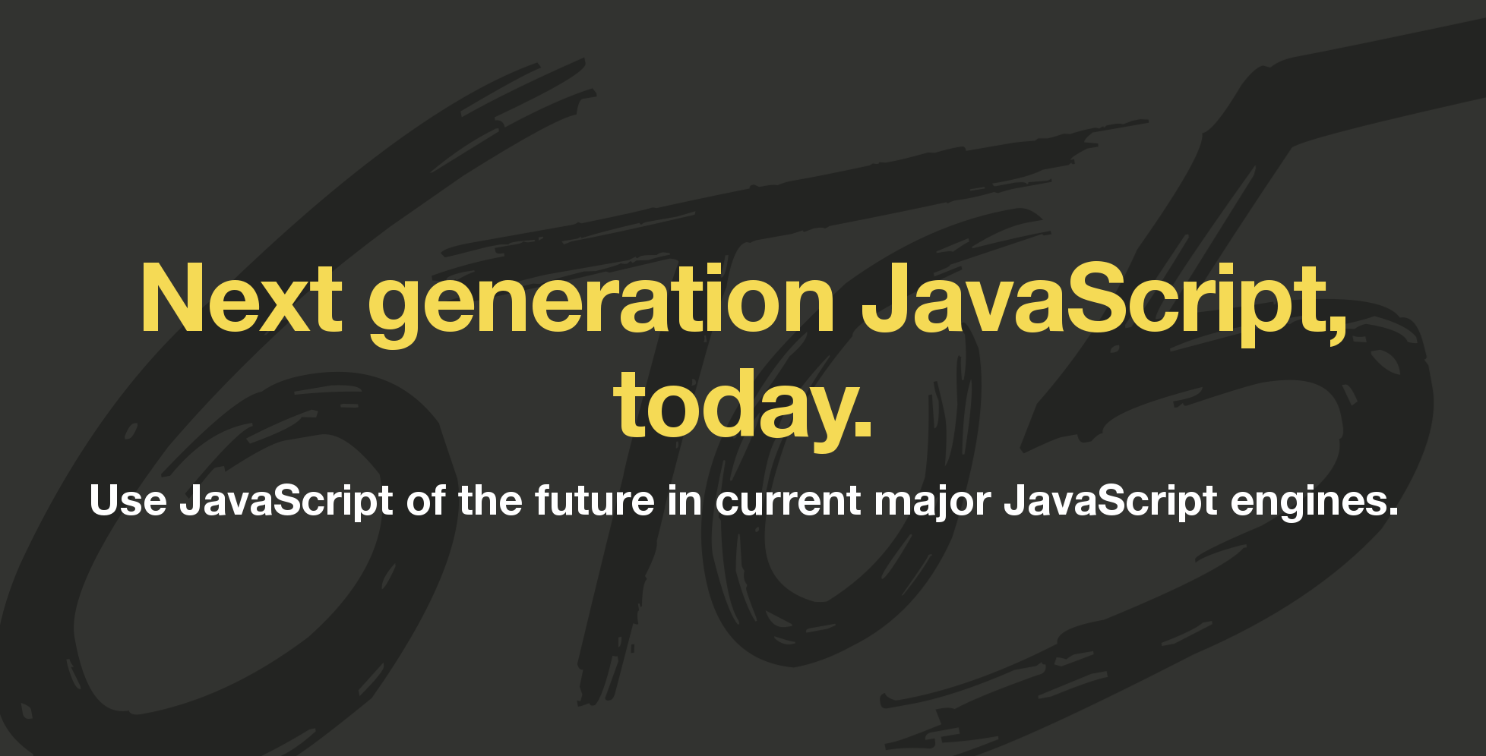
How ES6 Has Been Promoted

Slide 4
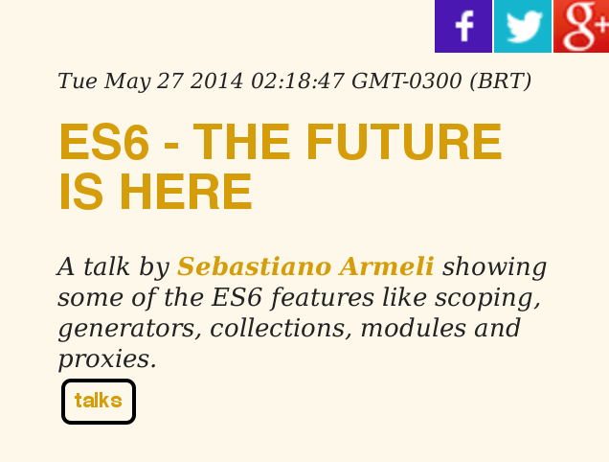
How ES6 Has Been Promoted

Slide 5
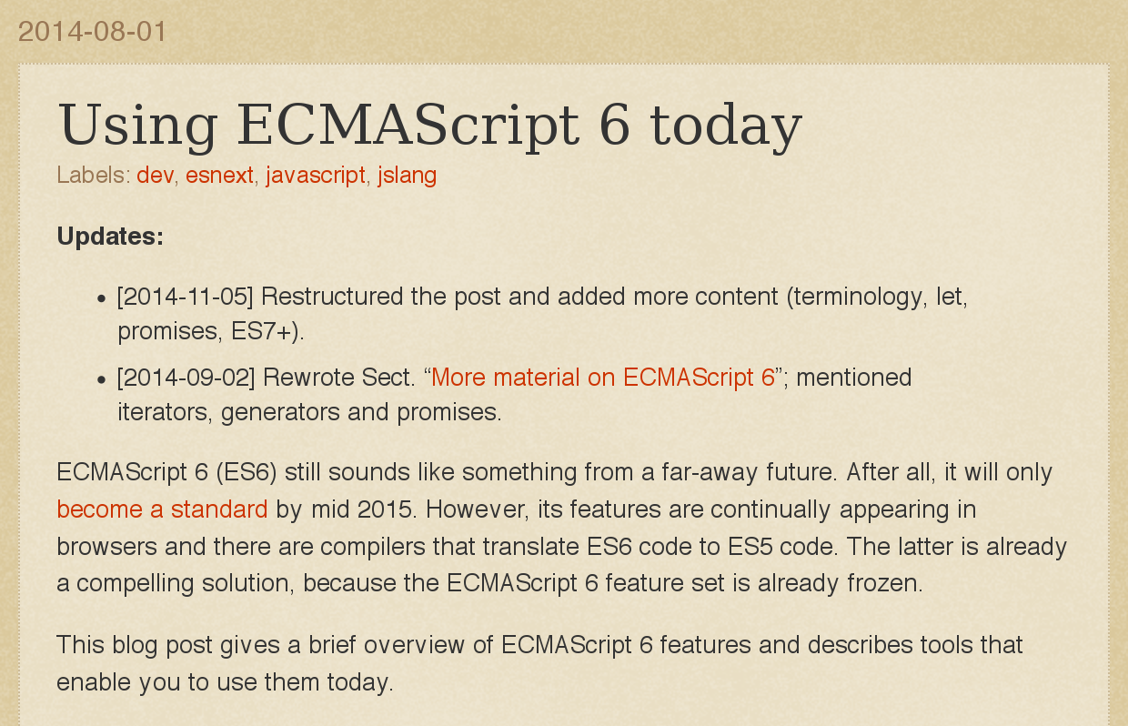
How ES6 Has Been Promoted

Slide 6
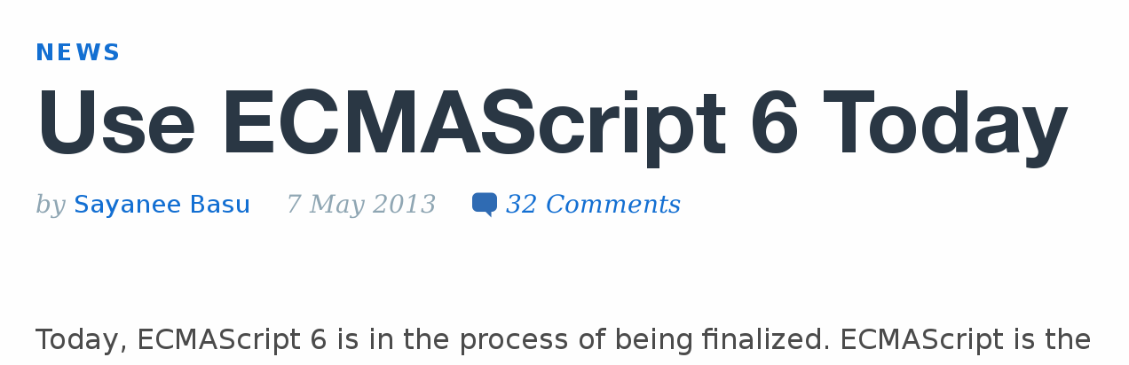
How ES6 Has Been Promoted

Slide 7

How ES6 Has Been Promoted

Slide 8
How Developers Reacted

Slide 9





How Developers Reacted

Slide 10

How Developers Reacted

Slide 11
What's on the ES6 menu?

Slide 12
What's on the ES6 menu?
fat arrow, classes, enhanced object literals, template
strings, destructuring, default/rest/spread arguments, let,
const, iterators via for..of, generators, comprehension,
unicode, modules, loaders, map, set, weakmap, weakset,
proxies, symbols, subclassable built-ins, promises,
math/number/string/object APIs, binary and octal literals,
reflect API, tail calls

Slide 13
...and what was possible already?

Slide 14
...and what was possible already?
take TypeScript, as example

Slide 15
...and what was possible already?
class Greeter {
greeting:String;
constructor(message:String) {
this.greeting = message;
}
greet(Void):String {
return "Hello, " + this.greeting;
}
}
var greeter:Greeter = new Greeter("world");

Slide 16

...and what was possible already?

Slide 17
...and what was possible already?
class Greeter {
var greeting:String;
function Greeter(message:String) {
this.greeting = message;
}
function greet(Void):String {
return "Hello, " + this.greeting;
}
}
var greeter:Greeter = new Greeter("world");

Slide 18
...and what was possible already?
yep, latter one is ActionScript 2 from 2003
“only” 9 years before via ES4

Slide 19
a matter of Point of View

Slide 20
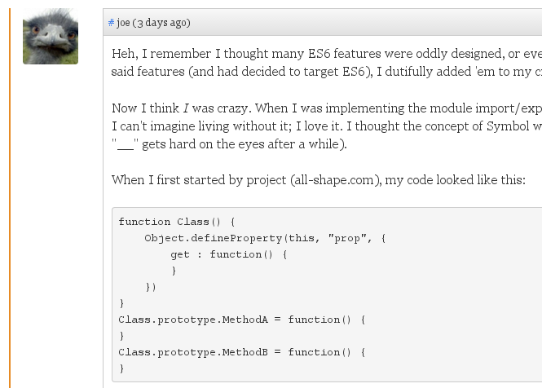
a matter of Point of View

Slide 21
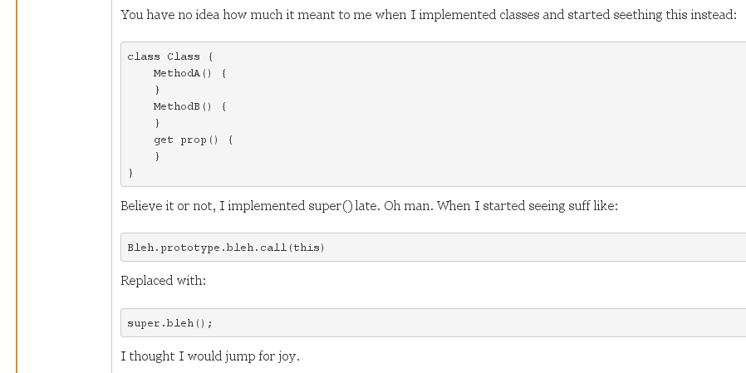
a matter of Point of View

Slide 22
Recap:

Slide 23
Recap:
How was he writing ?
function MyClass() {
Object.defineProperty(this, "prop", {
get : function() {
}
})
}
MyClass.prototype.MethodA = function() {
}
MyClass.prototype.MethodB = function() {
}

Slide 24
Recap:
How was he writing ?
How could have been instead ?
function MyClass() {
Object.defineProperty(this, "prop", {
get : function() {
}
})
}
MyClass.prototype.MethodA = function() {
}
MyClass.prototype.MethodB = function() {
}
var MyClass = Class({
methodA: function () {},
methodB: function () {},
get prop() {}
});

Slide 25
Recap:
What was he expecting ?
How could have been instead ?
class MyClass {
MethodA() {
}
MethodB() {
}
get prop() {
}
}
var MyClass = Class({
methodA: function () {},
methodB: function () {},
get prop() {}
});

Slide 26
Recap:
What was he expecting ?
What could I write already ?
class MyClass {
MethodA() {
}
MethodB() {
}
get prop() {
}
}
var MyClass = Class({
methodA() {},
methodB() {},
get prop() {}
});

Slide 27

Recap:
What was he expecting ?
What could I write already ?
class MyClass {
MethodA() {
}
MethodB() {
}
get prop() {
}
}
var MyClass = Class({
MethodA() {
},
MethodB() {
},
get prop() {
}
});

Slide 28
Recap:
What was he expecting ?
What could I write already ?
class MyClass {
MethodA() {
}
MethodB() {
}
get prop() {
}
}
var MyClass = Class({
methodA() {},
methodB() {},
get prop() {}
});
babel –whitelist=es6.properties.shorthand

Slide 29
Recap:
What was he expecting ?
What could I write already ?
class MyClass {
MethodA() {
}
MethodB() {
}
get prop() {
}
}
var MyClass = Class({
methodA() {},
methodB() {},
get prop() {}
});
babel –whitelist=es6.properties.shorthand
https://github.com/WebReflection/es-class

Slide 30
ES6 Classes
./class demo

Slide 31
ES6 Classes – The Good
after all these years we have a standard for classes
getters/setters easily on the prototype
getters/setters and methods are not enumerable
easy to call super
easy to subclass user classes and natives

Slide 32
ES6 Classes – The Bad
classes are not features complete
get/set & null objects can break on older browsers if transpiled
properties as defaults can't be defined
`super`, if present, can only be invoked before `this`
('cause `this` is undefined before `super`)
native classes subclassing is basically nowhere

Slide 33
ES6 Classes – The Hype
better options and with more features are ignored (ie es-class)

Slide 34
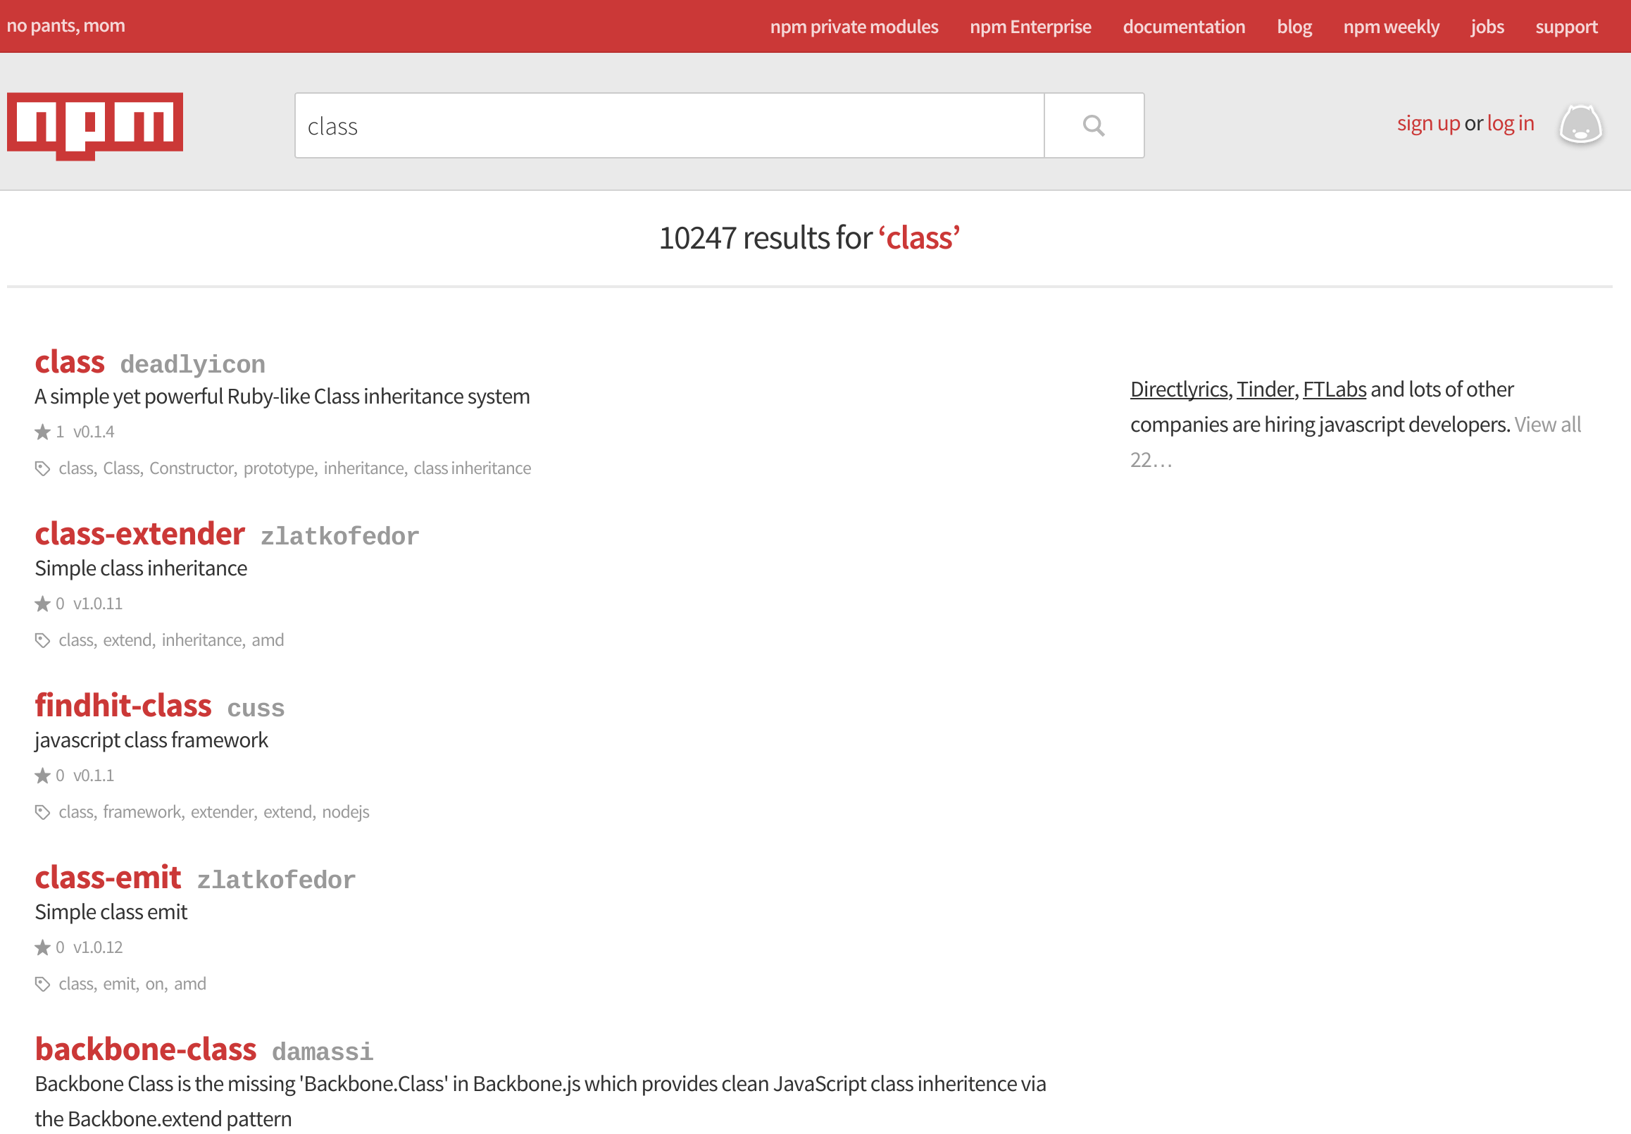

Slide 35


Slide 36
ES6 Classes – The Hype
better options and with more features are ignored (ie es-class)
getters/setters are suddenly OK to use
transpiled inconsistency? who cares! (ie node 0.10+__proto__)
composition sacrified due lack of traits
ain't nobody gonna need native subclassing

Slide 37
ES6 String Template

Slide 38
ES6 String Template
How it is in ES6
`test1 ${1 + 2} test2 ${3 + 4}`
function greetings(name) {
return `Hello ${name}!`;
}
console.log(greetings('Andrea'));
(function (name) {
return (
`Hello there,
this is ${name}!`
)}('Andrea'));
html`<a href="${href}">hello</a>`;

Slide 39
ES6 String Template
How it is in ES6
How it could have been since about ever
`test1 ${1 + 2} test2 ${3 + 4}`
function greetings(name) {
return `Hello ${name}!`;
}
console.log(greetings('Andrea'));
(function (name) {
return (
`Hello there,
this is ${name}!`
)}('Andrea'));
html`<a href="${href}">hello</a>`;
'test1 ${1 + 2} test2 ${3 + 4}'.template();

Slide 40
ES6 String Template
How it is in ES6
How it could have been since about ever
`test1 ${1 + 2} test2 ${3 + 4}`
function greetings(name) {
return `Hello ${name}!`;
}
console.log(greetings('Andrea'));
(function (name) {
return (
`Hello there,
this is ${name}!`
)}('Andrea'));
html`<a href="${href}">hello</a>`;
'test1 ${1 + 2} test2 ${3 + 4}'.template();
function greetings(user) {
return 'Hello ${name}!'.template(user);
}
console.log(greetings({name: 'Andrea'}));

Slide 41
ES6 String Template
How it is in ES6
How it could have been since about ever
`test1 ${1 + 2} test2 ${3 + 4}`
function greetings(name) {
return `Hello ${name}!`;
}
console.log(greetings('Andrea'));
(function (name) {
return (
`Hello there,
this is ${name}!`
)}('Andrea'));
html`<a href="${href}">hello</a>`;
'test1 ${1 + 2} test2 ${3 + 4}'.template();
function greetings(user) {
return 'Hello ${name}!'.template(user);
}
console.log(greetings({name: 'Andrea'}));
(function () {/*
Hello there,
this is ${name}!
*/}).template({
name: 'Andrea'
});

Slide 42
ES6 String Template
How it is in ES6
How it could have been since about ever
`test1 ${1 + 2} test2 ${3 + 4}`
function greetings(name) {
return `Hello ${name}!`;
}
console.log(greetings('Andrea'));
(function (name) {
return (
`Hello there,
this is ${name}!`
)}('Andrea'));
html`<a href="${href}">hello</a>`;
'test1 ${1 + 2} test2 ${3 + 4}'.template();
function greetings(user) {
return 'Hello ${name}!'.template(user);
}
console.log(greetings({name: 'Andrea'}));
(function () {/*
Hello there,
this is ${name}!
*/}).template({
name: 'Andrea'
});
'<a href="${href}">hello</a>'.template(
html, {href: href}
);

Slide 43
ES6 String Template
./strings demo
https://gist.github.com/WebReflection/8f227532143e63649804

Slide 44
ES6 String Template – The Good
finally a standard way to have multiline strings
can simplify ugly and error prone long strings concatenation
it's a fast and lightweight eval, open doors to new patterns
excellent shortcut for tests and debugging or HTML segments

Slide 45
ES6 String Template – The Bad
multiline will bring in unnecessary white spaces + no \r\n
despite the name, actually not good for templating
it's a fast and lightweight eval, open doors to new footguns
not suitable by default for i18n strings. This will hit developers

Slide 46
ES6 String Template – The Hype
using tools to merge templates was already possible
composing from external micro templates is better than having everything within the JS file
testability, isolation, i18n won't work if not evaluated within the template string once passed around
suddenly using evaluation is OK

Slide 47
ES6 WeakMap

Slide 48
ES6 WeakMap
It's a great way to relate objects without modofying them
also a great way to relate DOM nodes to JS Objects without needing to use an expando property (usually considered a dirty approach that could also be problematic)

Slide 49
ES6 WeakMap
It's a great way to relate objects without modofying them
also a great way to relate DOM nodes to JS Objects without needing to use an expando property (usually considered a dirty approach that could also be problematic)
Considering a generic link used as counter
var a = document.body.appendChild(
document.createElement('a')
);
a.textContent = 'click me';
a.href = '#mocked-href';

Slide 50
ES6 WeakMap
What can we do in ES6 today
var wm = new WeakMap;
a.addEventListener(
'click', setDataObject
);
function setDataObject(e) {
var el = e.currentTarget;
e.preventDefault();
if (!wm.has(el)) {
wm.set(el, {counter: 0});
}
console.log(++wm.get(el).counter);
}

Slide 51
ES6 WeakMap
What can we do in ES6 today
What we could have always done
var wm = new WeakMap;
a.addEventListener(
'click', setDataObject
);
function setDataObject(e) {
var el = e.currentTarget;
e.preventDefault();
if (!wm.has(el)) {
wm.set(el, {counter: 0});
}
console.log(++wm.get(el).counter);
}
a.addEventListener('click', {
handleEvent: function (e) {
e.preventDefault();
console.log(++this.counter);
},
counter: 0
});

Slide 52

ES6 WeakMap
What can we do in ES6 today
What we could have always done
var wm = new WeakMap;
a.addEventListener(
'click', setDataObject
);
function setDataObject(e) {
var el = e.currentTarget;
e.preventDefault();
if (!wm.has(el)) {
wm.set(el, {counter: 0});
}
console.log(++wm.get(el).counter);
}
a.addEventListener('click', {
handleEvent: function (e) {
e.preventDefault();
console.log(++this.counter);
},
counter: 0
});

Slide 53
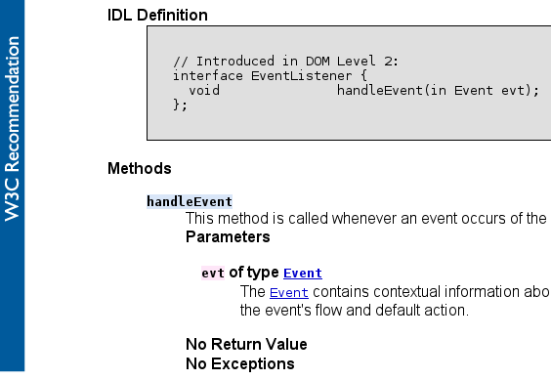
ES6 WeakMap
What can we do in ES6 today
What we could have always done
var wm = new WeakMap;
a.addEventListener(
'click', setDataObject
);
function setDataObject(e) {
var el = e.currentTarget;
e.preventDefault();
if (!wm.has(el)) {
wm.set(el, {counter: 0});
}
console.log(++wm.get(el).counter);
}
a.addEventListener('click', {
handleEvent: function (e) {
e.preventDefault();
console.log(++this.counter);
},
counter: 0
});

Slide 54
ES6 WeakMap
What can we do in ES6 today
What we could have always done
var wm = new WeakMap;
a.addEventListener(
'click', setDataObject
);
function setDataObject(e) {
var el = e.currentTarget;
e.preventDefault();
if (!wm.has(el)) {
wm.set(el, {counter: 0});
}
console.log(++wm.get(el).counter);
}
a.addEventListener('click', {
handleEvent: function (e) {
e.preventDefault();
console.log(++this.counter);
},
counter: 0
});

Slide 55
ES6 WeakMap
What can we do in ES6 today
What we could have always done
var wm = new WeakMap;
a.addEventListener(
'click', setDataObject
);
function setDataObject(e) {
var el = e.currentTarget;
e.preventDefault();
if (!wm.has(el)) {
wm.set(el, {counter: 0});
}
console.log(++wm.get(el).counter);
}
a.addEventListener(
'click',
new Counter
);

Slide 56
ES6 WeakMap
What can we do in ES6 today
What we could have always done
var wm = new WeakMap;
a.addEventListener(
'click', setDataObject
);
function setDataObject(e) {
var el = e.currentTarget;
e.preventDefault();
if (!wm.has(el)) {
wm.set(el, {counter: 0});
}
console.log(++wm.get(el).counter);
}
a.addEventListener(
'click',
new Counter
);
var Counter = Class({
handleEvent: function (e) {
e.preventDefault();
console.log(++this.i);
},
i: 0
});

Slide 57
ES6 WeakMap
What can we do in ES6 today
What we could have always done
var wm = new WeakMap;
a.addEventListener(
'click', setDataObject
);
function setDataObject(e) {
var el = e.currentTarget;
e.preventDefault();
if (!wm.has(el)) {
wm.set(el, {counter: 0});
}
console.log(++wm.get(el).counter);
}
a.addEventListener('click', {
handleEvent: function (e) {
e.preventDefault();
console.log(++this.counter);
},
counter: 0
});
https://github.com/WebReflection/dom-handler

Slide 58
ES6 WeakMap
./weakmap demo

Slide 59
ES6 WeakMap – The Good
a powerful way to relate objects in an unobtrusive way
a possible solution to obtain private properties behavior
a good pattern to help avoid leaks

Slide 60
ES6 WeakMap – The Bad
apparently very heavy in terms of GC pressure
impossible to polyfill without being obtrusive or without leaking
if abused can suffer both leaks and GC pressure

Slide 61
ES6 WeakMap – The Hype
already possible in the standard DOM world but ignored
instantly abused within constructors and private scopes
unaware of how weak polyfills work
unaware of failures and surprises behind polyfills

Slide 62
Symbols in a nutshell

Slide 63
Symbols in a nutshell
Good: the way to have unique Ids without abusing `Math.random()` and `new Date` + the way to mean protected properties and methods

Slide 64
Symbols in a nutshell
Good: the way to have unique Ids without abusing `Math.random()` and `new Date` + the way to mean protected properties and methods
Bad: do not scale with immutable variables + all polyfills are full of caveats

Slide 65
Symbols in a nutshell
Good: the way to have unique Ids without abusing `Math.random()` and `new Date` + the way to mean protected properties and methods
Bad: do not scale with immutable variables + all polyfills are full of caveats
Hype: adoption without fully understanding, i.e. `Object.assign`, `Object.getOwnPropertySymbols` and `Reflect.ownKeys`

Slide 66
Symbols in a nutshell
Good: the way to have unique Ids without abusing `Math.random()` and `new Date` + the way to mean protected properties and methods
Bad: do not scale with immutable variables + all polyfills are full of caveats
Hype: adoption without fully understanding, i.e. `Object.assign`, `Object.getOwnPropertySymbols` and `Reflect.ownKeys`
https://github.com/WebReflection/get-own-property-symbols

Slide 67
Destructuring

Slide 68
Destructuring Arrays
ES6
var value = [1, 2, 3, 4, 5];
var [el1, el2, el3] = value;

Slide 69
Destructuring Arrays
ES6
ES3
var value = [1, 2, 3, 4, 5];
var [el1, el2, el3] = value;
var value = [1, 2, 3, 4, 5];
with(named('el1, el2, el3', value)) {
console.log(el1, el2, el3);
}

Slide 70
Destructuring Arrays
ES6
ES3
var value = [1, 2, 3, 4, 5];
var [el1, el2, el3] = value;
var value = [1, 2, 3, 4, 5];
with(named('el1, el2, el3', value)) {
console.log(el1, el2, el3);
}
function named(str, value) {
for (var
o = {},
keys = str.split(/\s*,\s*/),
i = 0; i < keys.length; i++
) {
o[keys[i]] = value[i];
}
return o;
}

Slide 71
Destructuring Arrays
ES6
var [
,
firstName,
lastName
] = "John Doe".match(
/^(\w+) (\w+)$/
);

Slide 72
Destructuring Arrays
ES6
var [
,
firstName,
lastName
] = "John Doe".match(
/^(\w+) (\w+)$/
);
"This makes it really neat for example
to pull values out of regular expression
matches:"
https://strongloop.com/strongblog/getting-started-with-javascript-es6-destructuring/

Slide 73
Destructuring Arrays
ES6
ES3
var [
,
firstName,
lastName
] = "John Doe".match(
/^(\w+) (\w+)$/
);
if (/^(\w+) (\w+)$/.test("John Doe"))
with ({
firstName: RegExp.$1,
lastName: RegExp.$2
}) {
firstName, lastName;
}
"This makes it really neat for example
to pull values out of regular expression
matches:"
https://strongloop.com/strongblog/getting-started-with-javascript-es6-destructuring/

Slide 74
Destructuring Objects
ES6
var person = {
firstName: "John",
lastName: "Doe"
};
var {firstName, lastName} = person;

Slide 75
Destructuring Objects
ES6
ES3
var person = {
firstName: "John",
lastName: "Doe"
};
var {firstName, lastName} = person;
var person = {
firstName: "John",
lastName: "Doe"
};
with(person){ firstName, lastName }

Slide 76
Destructuring Objects
ES6
var person = {
dateOfBirth: [1, 1, 1980]
};
var {
dateOfBirth: [day, month, year]
} = person;

Slide 77
Destructuring Objects
ES6
var person = {
dateOfBirth: [1, 1, 1980]
};
var {
dateOfBirth: [day, month, year]
} = person;
which format?
DD/MM/YYYY or MM/DD/YYYY ?

Slide 78
Destructuring Objects
ES6
ES3
var person = {
dateOfBirth: [1, 1, 1980]
};
var {
dateOfBirth: [day, month, year]
} = person;
no need to mess up like that
which format?
DD/MM/YYYY or MM/DD/YYYY ?

Slide 79
Destructuring Function Arguments
ES6
function findUser(
userId, {
includeProfile,
includeHistory
}
) {
if (includeProfile);
if (includeHistory);
}

Slide 80
Destructuring Function Arguments
ES6
ES3
function findUser(
userId, {
includeProfile,
includeHistory
}
) {
if (includeProfile);
if (includeHistory);
}
function findUser(userId, options) {
if (options.includeProfile) ...
if (options.includeHistory) ...
}

Slide 81
Destructuring Function Arguments
ES6
ES3 (maybe?)
function findUser(
userId, {
includeProfile,
includeHistory
}
) {
if (includeProfile);
if (includeHistory);
}
function findUser(userId, options) {
if (options.includeProfile) ...
if (options.includeHistory) ...
}

Slide 82
Destructuring Function Arguments
ES6
ES3
function findUser(
userId, {
includeProfile,
includeHistory
}
) {
if (includeProfile);
if (includeHistory);
}
function findUser(userId, options) {
with ({
includeProfile: false,
includeHistory: false
}) with(options || {}) {
if (includeProfile);
if (includeHistory);
}
}

Slide 83
Destructuring – The Good
it simplifies named variables declaration ( [x,y,z] = pointArray )
it makes syntax more compact
...rest ( and ...spread ) ability is amazing !

Slide 84
Destructuring – The Bad
it might mislead assignment without defaults-ability
it brings in less predictable variables/properties greppability

Slide 85
Destructuring – The Hype
it has been similarily around for ages unnoticed

Slide 86
ES6 – The Good

Slide 87
ES6 – The Good
tons of new features developers have been asking for
tooling works already and is the most advanced we've ever had
there are new possibilities capable to unlock new JS potentials
new comers will probably find themselves more comfortable

Slide 88
ES6 – The Bad
few features are incomplete, might be a blocker for many
tooling might not fix problems in every target engine
debugging after tooling AND minification is a mess
new comers should learn “older” JS anyway to better deal with it

Slide 89
ES6 – The Hype
developers crave for the latest even if unnecessary or slower
incomplete, not fully cross-platform compatibility is suddenly OK
“works in Chrome? Good to go!” is unethical and unproductive

Slide 90
ES6 – A Better Approch
polyfills and transpilers might not work in your targets: have you test them **after** transpiling and minifying your code?

Slide 91
ES6 – A Better Approch
polyfills and transpilers might not work in your targets: have you test them **after** transpiling and minifying your code?
older browsers/engines become slower and slower because of wrapped, transpile, polyfilled, polluted environment: are you targeting these too?

Slide 92
ES6 – A Better Approch
polyfills and transpilers might not work in your targets: have you test them **after** transpiling and minifying your code?
older browsers/engines become slower and slower because of wrapped, transpile, polyfilled, polluted environment: are you targeting these too?
learn JavaScript, like “All The Things” !!! After that, feel free to choose your patterns accordingly. Don't stop with a superset or just classes, don't stop with a framework: there's more!

Slide 93
ES6 – A Better Approch
polyfills and transpilers might not work in your targets: have you test them **after** transpiling and minifying your code?
older browsers/engines become slower and slower because of wrapped, transpile, polyfilled, polluted environment: are you targeting these too?
learn JavaScript, like “All The Things” !!! After that, feel free to choose your patterns accordingly. Don't stop with a superset or just classes, don't stop with a framework: there's more!
Finally, feel free to go ES6 when appropriate!

Slide 94
ES6 – Last Quick Note
if you are writing “Universal JS”, please transpile before publishing to npm (or others)
https://medium.com/@mjackson/universal-javascript-4761051b7ae9

Slide 95

ES6 – Last Quick Note
if you are writing “Universal JS”, please transpile before publishing to npm (or others)
https://medium.com/@mjackson/universal-javascript-4761051b7ae9

Slide 96
ES6 Now: The Good, The Bad, and The Hype
Thank You!
by Andrea Giammarchi
@WebReflection

